Slide 1
Community Rehabilitation Providers
Working as a CRP

Slide 2
Working as a CRP 1
Introduce yourself to VR Staff
Market yourself as a CRP
Follow-up with a letter or email to VR Staff thanking & reminding them how to contact you.
http://www.labor.state.ak.us/dvr/contact.htm

Slide 3
Working as a CRP 2
Wait & receive a referral (generally a phone call) from a VR Counselor
Meet with VR Counselor & individual to discuss the purpose of referral
The individual, the VR Counselor and the CRP decide if the referral moves forward

Slide 4
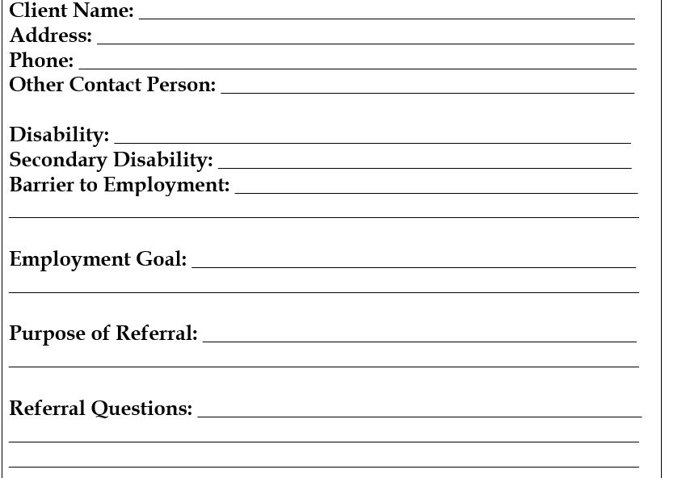
Accepting a Referral
Receive & review written referral from VR Counselor.

Slide 5
Referral Information Includes:
Name & contact information
Purpose and reason for the referral
Specific CRP service requested

Slide 6
More Referral Information
Individual background information to include:
Disability
Barrier to Employment
Employment Goal
Reports

Slide 7
Authorization for Purchase AFP 1

Slide 8
Authorization for Purchase AFP 2
The AFP is the official contract between you and DVR
Identifies the specific service. CRPs are authorized to provide only the service identified on the AFP
States the maximum number of hours a CRP is authorized to provide the service. CRPs must adhere to the number of hours authorized and will not be reimbursed for hours worked that are not authorized.
States the range of dates services must be provided. CRPs are required to provide the service within the date range specified.
Specifies the hourly rate of service the CRP can charge. Always review AFPs for accuracy and inform VR counselor of any errors prior to providing services.

Slide 9
AFP Don’ts
Begin services without an AFP
Provide a service that is not specified on an AFP
Provide more than the # of hours specified
Provide a service outside the specified date range
Use your own money to purchase services or items for a client

Slide 10
Guidelines to Providing Services
Link to services, service definitions, qualifications and CRP standards:
http://www.labor.state.ak.us/dvr/crp-service-def-req-hrly-rate-rng.pdf

Slide 11
More Guidelines
Contact VR Counselor ASAP when:
Your schedule or availability changes
Individual doesn’t show for an appointment
Individual is interested in or pursues a job that’s not identified on IPE
Suspected drug or alcohol use

Slide 12
Working as a CRP Summary
Ensure the following:
VR Counselors know who you are, what you do & how to contact you
Receive & understand referral information
Don’t start services without an AFP
Maintain close contact with VR Counselor

Slide 13
The End Thank you!

